Slide 1
Introduction to Bayesian Statistics and Computational Methods Antonietta Mira
Notes:
Thanks for the invitation

Slide 2
Aim of the course
Provide basic concepts of the
Bayesian approach
Subjective interpretation of probability
Use of Bayes theorem in updating information
Type of prior distributions
Introduce the use of Bayesian methods
for data analysis
Introduce to Monte Carlo (MC) and
Markov chain Monte Carlo (MCMC) simulations
Notes:
philosophy

Slide 3
Three approaches to Probability
Axiomatic (Kolmogorov)
Probability by definition and properties
Relative Frequency (classical, objective)
Repeated trials
Degree of belief (Bayesian, subjective)
Personal measure of uncertainty
Problems
The chance that by the end of the month the italian goverment will still be in place
The probability of rain tomorrow
Notes:
Succeed in driving Italy out of the economical crisis

Slide 4
Bayes Theorem
Thomas Bayes
Published works by Bayes
Background on probabilities
Bayes Theorem
Applications
Notes:
Historical overview
Conditional probability and Law of total probability

Slide 5
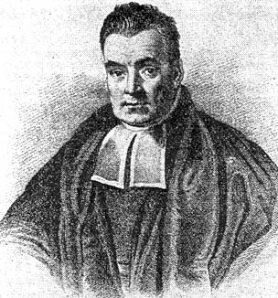
Thomas Bayes
Born in 1702, London
Little childhood information
Presbyterian Minister
In 1742, elected fellow by the Royal Society of London
Retired in 1752
Died in April of 1761
Notes:
Lived at the beginning of the 18° century

Slide 6
Written Work
Only two works published during his life
Divine Benevolence (1731)
Introduction to the Doctrine of Fluxions (1736)
He never published his mathematical works
“The probability of any event is the ratio between the value at which an expectation depending on the happening of the event ought to be computed, and the chance of the thing expected upon it’s happening”
Notes:
That focus on the areas of probability and statistics

Slide 7
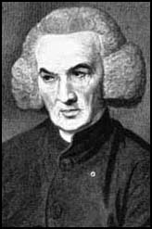
Publishing of Bayes Theorem
Richard Price (1723 –1791) examined Bayes’ work after his death
Responsible for the communication to the Royal Society on Bayes’ work
An Essay Toward Solving a Problem in the Doctrine of Chances
Notes:
We have to thanks Richard Price for examining Bayes’s work, communicating them to the RS and publishing them

Slide 8

An Essay Toward Solving a Problem in the Doctrine of Chances
a version of what becomes Bayes Theorem
the definition of conditional probability
If P (B) > 0, the conditional probability of A given B, denoted by P (A | B), is
P(A | B) = $\frac{P(A∩B)}{P(B)}$ = P(AB)/P(B)

Slide 9

Among the students at USI,
70% pass Statistics
55% pass Informatics
45% pass both
If a randomly selected passed Statistics, what is the probability he or she also passed Informatics?
P( Informatics | Statistics ) =
P( Informatics and Statistics )/P( Statistics )
= .45 / .7$≈$ .6429 or 64.29%

Slide 10
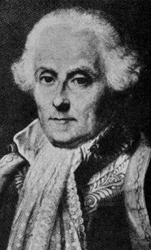
Pierre Simon Laplace (1749 – 1827)
French mathematician
Responsible for current form of Bayes Theorem
Bayes found the probability that x is between two values given a number of successes and failures
Laplace found an expression for the probability of a number of future successes and future failures given the number of successes and failures
Richard von Mises (1883-1953) states, “We owe Bayes only the statement of the problem and the principle of the solution. The theorem itself was first formulated by Laplace”
Notes:
Didn’t acknowledge Bayes right away

Slide 11
Law of Total Probability
Sometimes it is not possible to calculate P(A) however, it may be possible to find
P (A | B) and P (A | B^{c}) for some event B
Let B be an event with P (B) > 0 and P (B^{c}) > 0 Then for any event A:
P (A) = P (A | B) P (B) + P (A | B^{c}) P (B^{c})
Notes:
Calculate the probability of the occurrence of an event A
Can extend to a partition rather than B and B-complement that naturally form a partition

Slide 12
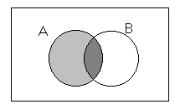
We know that P (A) = P (AB) + P (AB^{c})
Substitute in the conditional probability
P (AB) = P (A | B)P (B)
P (AB^{c}) = P (A | B^{c})P (B^{c})
The Law of Total Probability then becomes:
P (A) = P (A | B)P (B) + P (A | B^{c})P (B^{c})

Slide 13
An insurance company rents
40% of the cars for its customers from agency I
60% from agency II
If 6% of the cars from agency I
and 5% of the cars from agency II
break down
What is the probability that a car rented by this company breaks down?
P(car rented by insurance breaks down)
= (.4)(.06) + (.6)(.05)
= .054 = 5.4%

Slide 14

Bayes Theorem
Consider the sample space S of an experiment
and a partition {B₁, B₂, …, B_{n}},
with P (B_{i}) > 0, for i = 1, 2, …, n
Then, for any event A of S, with P (A) > 0
P (B_{k} | A) =$\frac{P\left(A | B_{k}\right)P\left(B_{k}\right)}{P\left(A | B_{1}\right)P\left(B_{1}\right)+P\left(A | B_{2}\right)P\left(B_{2}\right)+…+P\left(A | B_{n}\right)P\left(B_{n}\right)}$
P(B_{k}) is the prior probability
P(B_{k} | A) is the posterior probability
B₁ B₂ B₃
B₄
A
LTP

Slide 15

Proof:
P(A | B) = $\frac{P(AB)}{P(B)}$ , conditional probability
Rearranged becomes:
P (AB) = P (B) P (A | B)
P (BA) = P (A) P (B | A)
Therefore P (B)P (A | B) = P (A)P (B | A)
Solve for the P (B | A)
P (B | A) = $\frac{ P(A|B)P(B)}{P(A)}$

Slide 16

A box contains 7 red and 13 blue balls
Two balls are selected at random and are discarded without their colors being seen
If a third ball is drawn randomly and observed to be red, what is the probability that both of the discarded balls were blue?
Solve P (BB | R)
= $\frac{P(R|BB)P(BB)}{P\left(R | BB\right)P\left(BB\right)+P\left(R | BR\right)P\left(BR\right)+P(R|RR)P(RR)}$
=$\frac{\frac{7}{18}∗\frac{39}{95}}{\frac{7}{18}∗\frac{39}{95}+\frac{6}{18}∗\frac{91}{190}+\frac{5}{18}∗\frac{21}{190}}≈0.46$

Slide 17

Applications
Diagnostic testing
Tests identify if a person has a particular disease or not
Tests are not always 100% correct
If a person tests positive for a disease is he or she truly sick?
A cancer is found in 1 in every 2000 people. If a person has the disease w.p. 90% the test will result positive. If a person does not have the disease, the test will result in a false positive 1% of the time.
The probability that a person with a positive test really has cancer:
P (Cancer | Positive Test) = $\frac{\frac{1}{2000}∗0.90}{\frac{1}{2000}∗0.90+\frac{1999}{2000}∗0.10}≈0.43$

Slide 18
Introduction to Bayesian Statistical Inference
Statistical inference is used to draw conclusions from known data in samples to populations for which data is unknown
EXAMPLE: Find the probability that an African man’s height is over 1.75 meters

Slide 19
If we have no info about this man, the probability is based on the proportion of Africans taller than 1.75 meters
Frequentist approach
However, if we have prior knowledge about the man, it must be factored into the probability
If he plays basketball, the probability will be larger than population proportion
Bayesian approach

Slide 20
Bayesian approach to modeling
p(θ|Y) = p(Y|θ) p(θ) / p(Y)
p(θ ) is the prior for θ
What do we know about θ independently of the data?
p(Y) = Σ p(θ) p(Y|θ) or ∫ p(θ) p(Y|θ) dθ
i.e., the probability of the data for all values of θ
(constant – calculate analytically or numerically)
Is known as the “marginal likelihood”
Notes:
Prova 4

Slide 21
The other terms in Bayes formula are:
Inverse probability:
Bayes formula goes from p(Y|θ) to p(θ|Y)
Bayes and Laplace were objective Bayesians
they viewed the prior with suspicion: Laplace proposes to choose a uniform (constant) prior in order not to bias the inferencial process
Subjective Bayesians arose later in the 1940s and 1950s, with Savage and de Finetti
p(θ|Y)
p(Y|θ)
Posterior
Likelihood

Slide 22
Critics to uniform prior
In the 19th century: objection that one-to-one transformations of θ may yield different prior densities For instance: a uniform prior on the success probability, θ implies a non-uniform prior on the odds ρ=θ/(1- θ)
In other words, we are encoding prior ignorance for θ, but not for ρ, even if it is one-to-one transformations
In the 20th century:
search for statistical practice without prior

Slide 23
Inference without priors
We have some data Y, and want to know about θ
can be unknown parameters, missing data, latent variables ...
Eg: sample of data from a normal distribution, what is the population mean?
Frequentist: estimate θ through the likelihood: p(Y|θ)
How likely is Y for given values of θ ?
Use moment estimators or maximum likelihood, the latter proposed by Sir Ronald A. Fisher (1890–1962), against the Bayes-Laplace original inferencial paradigm

Slide 24
Bayes-Laplace paradigm: really want to know about p(θ|Y)
Jerzy Neyman (1894–1981) founded Frequentism
It asks how the results would change if you ran a procedure over and over again (with different samples/data)
While Bayesians CONDITION upon the given sample
DATA is GIVEN
Finally, Abraham Wald (1902–1950)
developed Decision Theory
It formalizes what inference is and quantifies how good a method is using loss-utility functions and risk

Slide 25
Subjective vs Objective Bayesian
L. J. Savage (1917-71) and Bruno de Finetti (1906-85)
They found paradoxes and incoherencies in the frequentist framework, and, in reaction, embraced the prior, emphasizing its subjectivity
At about the same time, Harold Jeffreys (1891-1989) started the objective Bayesian approach (see book by S. Stigler, 1986):
use frequentist analytic tools to guide the choice of priors, including: consistency, rates of convergence, unbiasedness, admissibility
The appeal of these tools is that they are automatic (especially useful when there are many parameters) and do not require a domain expert

Slide 26
Why Bayes?
Bayesian methods allow us to:
Think differently about interpreting and estimating parameters (unknown random)
“what are possible values of this parameter, based directly on the posterior distribution p(θ|Y)?”
Combine prior information with the data
“what else do I know about θ?”
Describe many sources of uncertainty in the model
“how sure am I about the inputs to my model?”
Describe complex systems using hierarchical or
multi-level models
Notes:
Allows incorporation of imperfect/imprecise information in the decision process
conditional perspective: condition upon the observations

Slide 27
Why Bayes?
Bayesian computational methods
(such as MCMC) allow us to:
Use non-standard distributions as LHD
Fit very complex non-linear models
Obtain a very wide variety of estimates
Make a very wide range of inferences, based directly on posterior probabilities
(CI, HP, Prediction)
Avoids averaging over the unobserved values of x
Coherent update of the info on θ
Notes:
Provides a complete inferential scope and an unique motor of inference

Slide 28
Another motivation for Bayes: de Finetti’s Theorem (1)
Deﬁnition: Inﬁnite exchangeability
(y₁,y₂,...) is an inﬁnitely exchangeable sequence of rvs if, for any n and any permutation π of 1,…,n:
p(y₁,y₂,...,y_{n}) = p(y_{π(1)},y_{π(2)},...,y_{π(n)})
Note: this is not equivalent to independent and identically distributed (iid) rvs
iid rvs infinitely exchangeable rvs

Slide 29
Another motivation for Bayes: de Finetti’s Theorem (2)
Theorem of de Finetti, 1930s: (y₁,y₂,...) is inﬁnitely exchangeable iff, for all n,
P(y₁,y₂,..., y_{n}) = ∫ П_{i} p(y_{i}|θ) F(dθ)
This means that for exchangeable data,
There must exist a parameter θ
There must exist a likelihood p(y|θ)
There must exist a prior F on θ
The above quantities are such that (y₁,y₂,...,y_{n}) are conditionally independent

Slide 30
Exchangeability example: information retrieval
Assume that the order of words in a document does not matter.
The words are not iid: if we see the French words voyage (travel) and passeport (passport), we expect the rest of the document to be both in French and on a subject related to travel
We assume infinite exchangeability
there is some θ governing these intuitions
θ can also be of infinite dimension (a stochastic process), as in nonparametric Bayesian

Slide 31
Example: Estimating a proportion
Data: Suppose that we observe n=29 sites with Y=22 presences of a species (and 7 absences). What is the probability θ of presence of the species?
(Or: Suppose that we have n=29 patients; Y=22 survive and 7 die. What is the probability of survival?)
Unobserved: θ probability of success
Likelihood: Y has a Binomial distribution
Likelihood: P( Y | θ ) ∝ θ^{y} (1-θ)^{n-y}
p(Y|θ) ~ Bin(29, θ)
p(Y=22|θ)∝θ²²(1-θ)⁷

Slide 32
The Beta Distribution
Prior for θ: Many choices: - point estimate - Beta distribution (continuous over range 0,1)
θ ~ Beta(a,b)
p(θ) ∝ θ^{a-1} (1-θ)^{b-1}
E(θ) = a/(a+b) Var(θ) = ab/{(a+b)²(a+b+1)} Mode(θ) = (a-1)/(a+b-2)
a=b mean= 0.5 symmetric

Slide 33
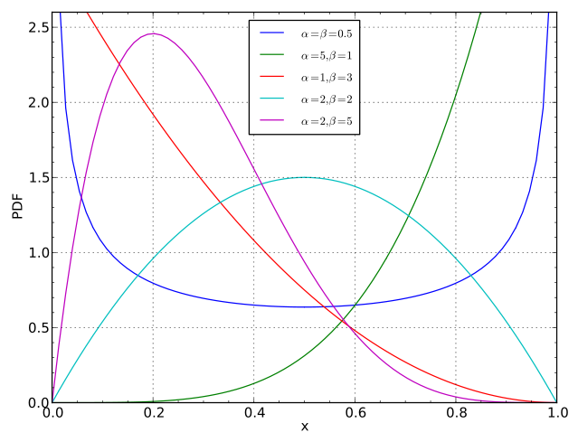
Beta distribution
a<1, b<1 U-shaped
a>1, b>1 Unimodal
a<1, b≥1 Positive skewed
a≥1, b<1 Negative skewed
a=1, b>1 Stricktly decreasing
a>1, b=1 Strickly increasing

Slide 34
The Beta Distribution
Match the plots to the distributions
https://keisan.casio.com/exec/system/1180573226
What are the posterior means, modes and variances?
Beta(1,1) Beta(2,2) Beta(100,100) Beta(2,1) Beta(10,20) Beta(9,1)

Slide 35
DAG: Binomial model
Model
Y ~ Binomial (θ, n)
θ ~ Beta (a,b)
a
b
θ
n
Y

Slide 36
Priors for binomial model
Prior: Some alternatives
1. Assume we ‘know nothing’ about θ, so we set a uniform prior θ~U[0,1] , equivalently, θ ~ Beta(1,1)
2. Based on past information, adopt a Beta(9,1) prior
3. Based on expert info, assume a Beta(100,100) prior

Slide 37
Posterior for binomial model
P(θ | y) ∝ likelihood × prior = θ^{y} (1-θ)^{n-y} × θ^{a-1} (1-θ)^{b-1}
= θ^{y+a-1} (1-θ)^{n-y+b-1}
= Beta(y+a, n-y+b)
E(θ ) = a / (a + b)
E(θ | y) = (a + y ) / (a + b + n )

Slide 38
Influence of prior on posterior
E(θ | y) = (a + y) / (a + b + n )
=n/(a+b+n)*y/n + (a+b)/(a+b+n)*E(θ )
The posterior mean is a compromise between prior mean and sample mean
The stronger the prior (a+b), the more weight the prior has in the posterior
The larger the sample size, the more weight the likelihood has in the posterior

Slide 39
Your turn!
Binomial example with 22 presences, 7 absences:
Consider the following priors for θ:
Beta(1,1) Beta(9,1) Beta(100,100)
For each of these:
What is the prior mean for θ?
What is the posterior distribution for θ?
What is the posterior mean for θ?
What general conclusions can you make
about the influence of priors and sample size?

Slide 40
Answers:
Sample proportion = 22/29 = 0.76
Beta(1,1):
Prior mean = 1/(1+1) = 0.5
Posterior mean = (22+1)/(29+2) = 0.74
Beta(9,1):
Prior mean = 9/(9+1) = 0.90
Posterior mean = (22+9)/(29+10) = 0.79
Beta(100,100):
Prior mean = 100/(100+100) = 0.5
Posterior mean = (22+100)/(29+200) = 0.53

Slide 41

Biased coin
P(Heads) = P( Y = 1) p = ?
0-1 i.i.d. Bernoulli(p) trials
Let $Y=\sum{Y_{i}}$ be the number of heads in n trials
Likelihood is$f\left(Y | p\right)∝p^{y} {(1−p)}^{1−y}$
For prior use uninformative distribution on (0,1)
So posterior distribution is proportional to
$f\left(Y | p\right)f(p)∝p^{Y} {(1−p)}^{n−Y}$
$f\left(p | Y\right)f(p)∝p^{Y} {(1−p)}^{n−Y}$
Notes:
Uniform = Beta (1, 1)

Slide 42
Toss the coin 10 times
Data: T, T, H, T, T, T, T, H, T, H
0, 0, 1, 0, 0, 0, 0, 1, 0, 1
n=10 and y=3
Posterior distribution is
Beta(3+1,7+1) = Beta(4,8)

Slide 43
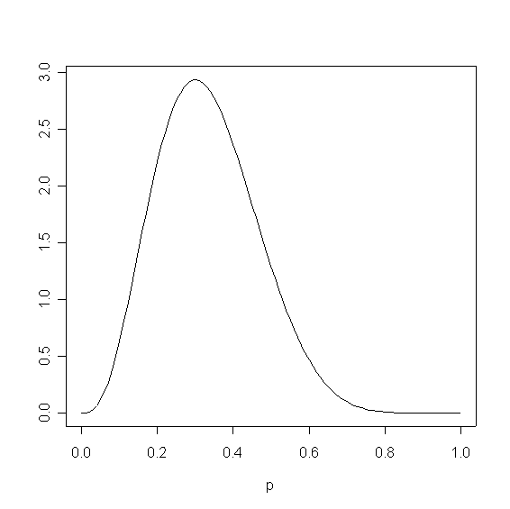
Posterior distribution Beta(4,8)
Mean: 0.33
Mode: 0.30
qbeta(.025,4,8) = 0.11
qbeta(.975,4,8) = 0.61
[.11, .61] is the 95%
credible interval for p
P(.11 < p < .61 | y ) = .95

Slide 44
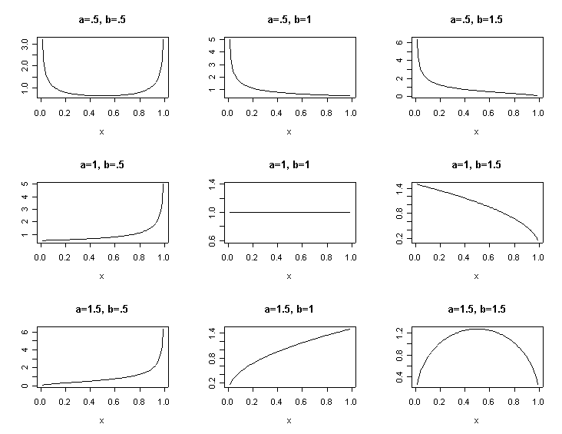
Choice of Prior distributions
Notes:
A = 0.5 on first row and then grows in second row (1) and grows again in the third row (1.5)
B = 05 on first column and then grows in the second column (1) and then grows again to 1.5
Diagonal a=b: symmetric

Slide 45
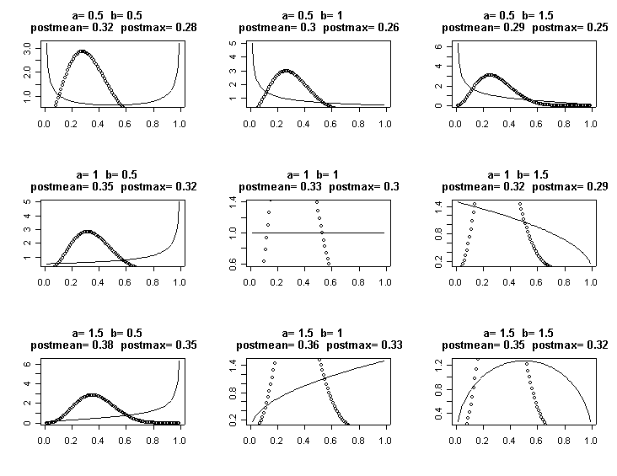
Posterior distribution is Beta(y+a, n-y+b)

Slide 46
Dirichlet – Multinomial Model
MULTINOMIAL DISTRIBUTION
p(Y=(Y₁,Y₂,…,Y_{k})|θ) ~ Multi(k, θ=(θ ₁, θ ₂,…, θ _{k}))
∝ θ₁^{y1} θ₂^{y2} …(1 - θ₁− θ₂ − θ_{κ−1} ) ^{yk}
generalization of the binomial
For n independent trials each of which leads to a success for exactly one of k categories
Each category has a given fixed success probability
Ex: In a three-way election:
candidate A: 20% of the votes
candidate B: 30% of the votes
candidate C: 50% of the votes
If six voters are selected randomly, what is the prob that there will be one supporter for candidate A, three for candidate B and two for candidate C in the sample?

Slide 47
Multinomial Model
p(Y|θ) ~ Multi(3, θ=(0.2,0.3,0.5))
p(Y=(1,3,2)|θ)∝θ₁¹ θ₂³ (1 - θ₁− θ₂)²
this is the likelihood of the multinomial model
To evaluate the LHD we can use the R command:
dmultinom(x=c(1,2,3),prob=c(0.2,0.3,0.5)) = 0.135

Slide 48
DIRICHLET DISTRIBUTION
p(θ=(θ ₁, θ ₂,…, θ _{k})) ~ Dir(α=(α₁,α₂,...,α_{k}))
∝ θ₁^{α1−1} θ₂^{α2−1}...(1 - θ₁− θ₂ − ...θ_{κ−1} )^{ακ−1}
multidimensional continuous density in [0,1]^{k}
generalization of the Beta
prior for probability parameters of the multinomial
Ex: In the three-way election, instead of a fixed
= (20%, 30% ,50%)
θ can be random, following the Dirichlet distribution with k = 3

Slide 49
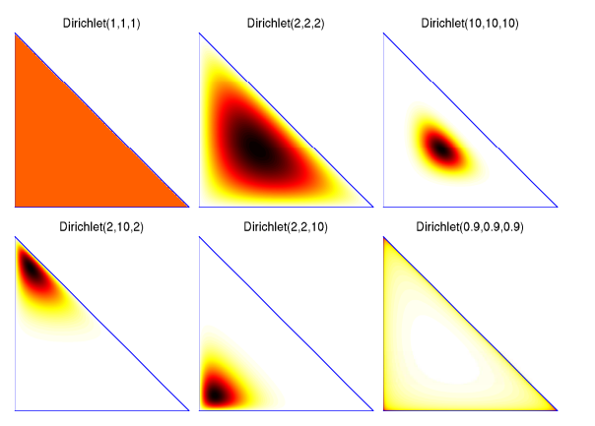
Examples of Dirichlet distributions
For the constraint θ_{k}=1−θ₁−...−θ_{k−1} it has support in the (k-1)-simplex
The graph on the left shows examples of the distribution when the n° of categories k=3
For k=2, it reduces to the beta distribution
Source: Ghahramani, Z. (2005),
Tutorial on Nonparametric Bayesian Methods

Slide 50
Dirichlet-Multinomial Model
In the election example we take a Dirichlet prior for the parameter θ:
p(θ) ~ Dir(α=(α₁,α₂,α₃))
p(θ) ∝ θ₁^{α1−1} θ₂^{α2−1} (1−θ₁−θ₂) ^{α3−1}
Mean: E(θ_{i}) = α_{i}/α₀
Variance: V(θ_{i}) = α_{i} (α₀- α_{i})/(α₀ (α₀+1))
Covariance: Cov(θ_{i} ,θ_{j}) = - α_{i} α_{j}/(α₀ (α₀+1))
α₀ := α₁+...+ α_{k}

Slide 51
DAG: Dirichlet-Multinomial model
Model + Prior
Y=(Y₁,…,Y_{k}) ~ Multinomial (n,θ )
θ = (θ₁,..., θ_{k})~ Dirichlet (α₁,...,α_{κ})
…
α₁
α_{κ}
θ
n
Y

Slide 52
Posterior for Multinomial model
P(θ | y) ∝ likelihood × prior ∝ θ₁^{y1} θ₂^{y2} ... (1-θ₁-…-θ_{κ−1})^{yk} ×
θ₁^{α1−1} θ₂^{α2−1} ... (1-θ₁-…-θ_{κ−1}) ^{ακ−1}
= θ₁^{y1+α1−1} θ₂^{y2+α2−1} ... (1-θ₁-…-θ_{κ−1}) ^{yκ+ακ−1}
∝ Dirichlet (y₁+α₁,..., y_{k}+α_{κ})
Prior mean: E(θ_{i} ) = α_{i} / α₀
Posterior mean: E(θ_{i} | y) = (α_{i} + y_{i}) / (α₀ + n )

Slide 53
Influence of prior on posterior
E(θ_{i} | y) = (α_{i} + y_{i}) / (α₀ + n)
The posterior mean is a compromise btw prior mean and observed proportion of i-th category
As in the binomial model:
the stronger the prior α_{ι}, the more weight the prior has in the posterior
the larger the sample size, the more weight the likelihood has in the posterior

Slide 54
Multinomial example
Back to the election example:
Likelihood: p(Y=(1,3,2)|θ)∝θ₁¹ θ₂³ (1-θ₁₋θ₂)²
Prior: p(θ) ∝ θ₁^{α1−1} θ₂^{α2−1} (1−θ₁−θ₂) ^{α3−1}
Fix (α₁, α₂, α₃) = (1,1,1) (uninformative)
E(θ₁ ) = 1/3 E(θ₁ | Y) = (1+1)/(3+6)=2/9
Fix (α₁, α₂,α₃) = (1,3,1) (prior information)
E(θ₁ ) = 1/5 E(θ₁ | Y) = (1+1)/(5+6)=2/11

Slide 55
Conjugate priors
It might be reasonable to expect the posterior distribution to be of the same form as the prior distribution
This is the principle of conjugacy
For a Binomial likelihood a Beta prior distribution is conjugate: a Beta posterior is obtained as a result of Bayes theorem
For a Multinomial likelihood a Dirichlet prior distribution is conjugate

Slide 56
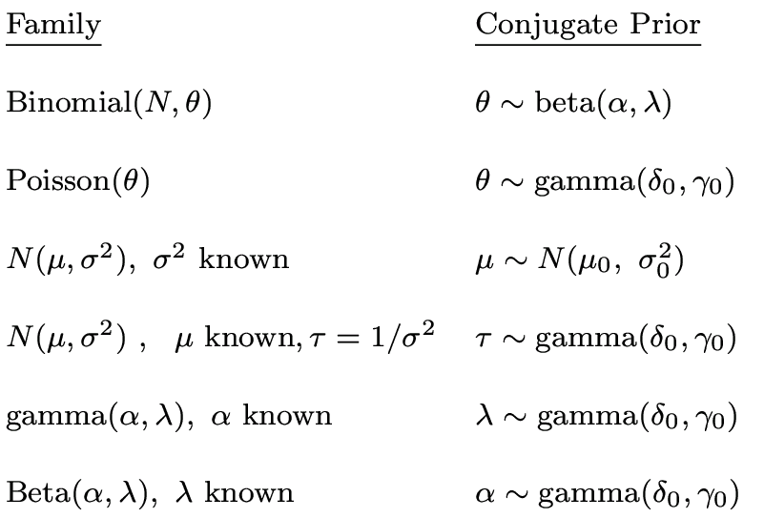
Conjugate priors

Slide 57
Strategies for prior determination
Partition Θ in sets (e.g., intervals)
find the probability of each set
Approach π by an histogram
Select significant elements of Θ and evaluate their respective likelihood
Empirical Bayes
Hierarchical Bayes

Slide 58
Improper prior
Not a distribution
Often only way to derive a prior in noninformative settings
Performances of associated estimators usually good
Often occur as limits of proper distributions
Check if the posterior is still proper

Slide 59
Noninformative priors
Noninformative priors cannot be expected to represent exactly total ignorance about the problem at hand, but should rather be taken as reference or default priors, upon which everyone could fall back when the prior information is missing.
—Kass and Wasserman, 1996—

Slide 60
Jeffreys’ prior (1891–1989)
Limits of uninformative flat priors:
Not invariant to one-to-one transformation. Ex: ignorance on θ does not imply ignorance on ρ=θ/(1− θ)
It can be very informative. Ex: a flat prior in high dimension says that most of the mass lies at ∞
Jeffrey’s prior
Parameterization invariant
Proportional to sqrt(|Fisher Information|) where |.| is the determinant
Suffers from dimensionality curse

Slide 61
Jeffreys’ prior
p(θ) ∝ |I(θ)|^{1/2}
where I is the Fisher Information:
I(θ) = -E_{θ}[d² log p(Y|θ)/dθ²]
Ex: Y ~ Bin(n,θ) ∝ θ^{y}(1− θ)^{n-y}
The Fisher information is: I(θ) = n / (θ(1−θ))
p(θ) ∝ θ^{-1/2}(1−θ)^{-1/2} ∝ Beta(1/2, 1/2)

Slide 62
Jeffreys’ prior curse of dimensionality
It does not work well with multidimensional parameters
Ex 1: Estimate ||θ||² when Y ~ N(θ,Ι) p-dimensional
Jeffrey’s prior is flat, posterior is non-central chi-square
E(||θ||² | Y)=||Y||²+p
but the min variance estimate is ||Y||²-p
Ex 2: Y ~ N(μ,σ²), θ=(μ,σ²) → p(θ)=1/σ²
with poor convergence properties

Slide 63
Reference priors
Objective priors. Proposed by Bernardo (1979) and developed by Berger (1980s)
Idea: an uninformative prior should maximize
the divergence between posterior and prior
It takes divergence expectation given data distribution
Possible distances: Kullback-Leibler divergence or the Hellinger distance
The data maximizes their effect on posterior

Slide 64
Reference priors: K-L divergence
We want to maximizes K-L between p(θ) and p(θ|Τ), T=T(X) sufficient statistic:
KL = ∫p(θ|Τ) log p(θ|Τ)/p(θ) d θ
p*(θ) = argmax_{p(θ)} ∫ KL p(t) dt
Invariant under reparameterization
Calculus of variation problem

Slide 65
Dynamic Updating
If we obtain more data, we do not have to redo all of the analysis: our posterior from the first analysis simply becomes our prior for this next analysis
Binomial example:
Stage 0: Prior p(θ) ~ Beta(1,1); ie E(θ)=0.5
Stage 1: Observe y=22 ‘presences’ from 29 sites Likelihood: p(y|θ)~Bin(n=29,θ) Posterior: p(θ|y)~Beta(23,8); ie E(θ|y) = 0.74
Stage 2: Observe 5 more ‘presences’ from 10 sites Likelihood: p(y|θ)~Bin(n=10,θ) Prior p(θ)~Beta(23,8) Posterior p(θ|y)~Beta(28,13); ie E(θ|y) = 0.68

Slide 66
Example: Estimating a normal mean
n observations Y = (y₁,..,y_{n}) from a normal distribution, unknown mean μ, known variance σ²
Likelihood: p(y_{i}|θ) y_{i} ~ N(μ, σ ²) p(Y|θ) = (2πσ²)^{-n/2}exp(-0.5Σ_{ι}(y_{i}- μ)²/σ²)
Prior: A conjugate prior is θ ~ N(μ₀ ,σ₀²) p(θ) = (2πσ₀²)^{-1/2} exp(-0.5(θ-μ₀)²/σ₀²)
μ₀ ,σ₀² can be specified values representing
our “best guess” at the true mean and how
certain we are of this.
Or we can put priors on these values as well: hierarchical model

Slide 67
Normal Model, known variance
Posterior:
p(μ|Y) ~ N(μ₁, σ₁²)
μ₁ = ( μ₀ / σ₀² + n y / σ² ) / (1/σ₀² + n/σ²)
1/σ₁² = 1 / σ₀² + n / σ²
Posterior mean is
a weighted average
of prior and data
Posterior variance also
combines variances from
prior and data

Slide 68
Your turn!
Suppose that we observe y = 2 and wish to estimate the population mean μ
Assume model: p(y|μ) ~ N(μ,σ²=3) Assume prior: p(μ) ~ N(μ₀=1.5 , σ₀²=1)
What is the posterior distribution for μ?
What if the prior is N(2,1)? N(1.5,10)?
5. Verify the equations on the previous slide

Slide 69
Answers
Observe y = 2 ; p(y|μ) ~ N(μ,σ²=3)
If prior p(μ) ~ N(μ₀=1.5 , σ₀²=1) then the posterior is p(μ|y) ~ N(μ₁, σ₁²)
posterior mean: μ₁ = (1.5/1 + 2/3) / (1/1 + 1/3) = 1.625
posterior variance: 1/σ₁² = 1/1 + 1/3 + 1.333 so σ₁² = 0.75
If prior p(μ) ~ N(μ₀=2 , σ₀²=1) μ₁ = ( 2/1 + 2/3) / (1/1 + 1/3) = 2
1/σ₁² = 1/1 + 1/3 = 1.333 so σ₁² = 0.75
If prior p(μ) ~ N(μ₀=1.5 , σ₀²=10) μ₁ = ( 1.5/10 + 2/3) / (1/10 + 1/3) = 1.88
1/σ₁² = 1/10 + 1/3 = 0.4433 so σ₁² = 2.31

Slide 70
Normal model, unknown mean unknown variance
σ ~ Uniform(a,b)
Posterior = ?
uniform
probability
p(σ)
a
b

Slide 71
Normal model, unknown mean unknown variance
Joint PRIOR for μ and τ = 1/ σ² = precision
p(μ, τ) = p (μ | τ) p(τ)
μ | τ ̴ N (μ, τ₀)
τ ̴ Gamma (α, β)
Then we say that the prior is a Normal-Gamma
(μ , τ ) ̴ N-Gamma ( τ, α, β)

Slide 72
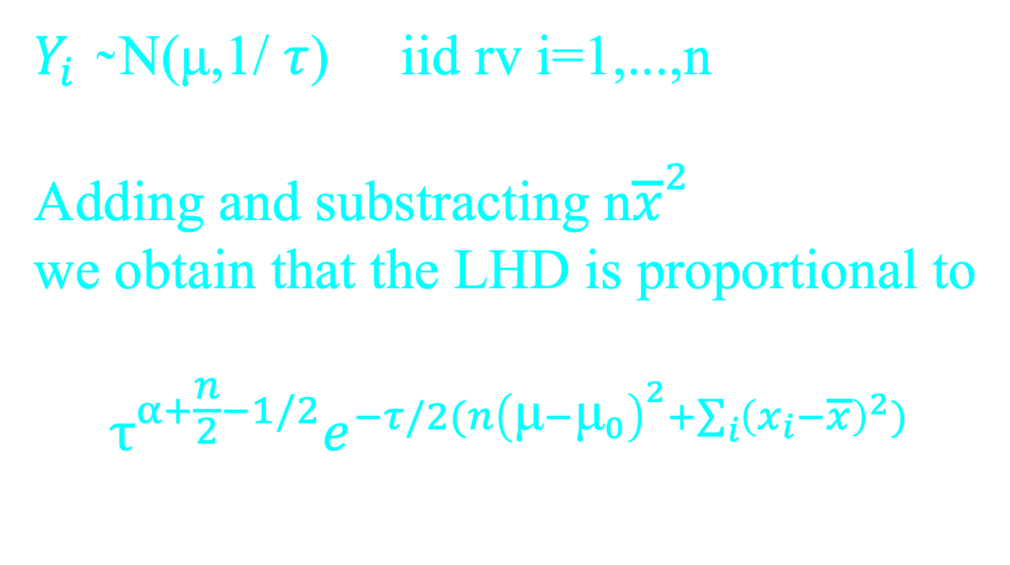
Normal model, unknown mean unknown variance
$Y_{i}$ ̴ N(μ,1/ $τ$) iid rv i=1,...,n
Adding and substracting n${\overline{x}}^{2}$
we obtain that the LHD is proportional to
$$τ^{α+\frac{n}{2}−1/2}e^{−τ/2(n{\left(\text{μ}−{\text{μ}}_{0}\right)}^{2}+\sum_{i}{{\left(x_{i}−\overline{x}\right)}^{2}})}$$

Slide 73
Normal model, unknown mean unknown variance
POSTERIOR is proportional to PRIOR x LHD
and by completing square brackets
we have that the posterior is again a
Normal-Gamma i.e.
μ|τ,x ̴ N(m,1/τ)
τ | x ̴ Gamma(a,b )

Slide 74
Credible Intervals and Regions
The Bayesian equivalent of frequentist confidence intervals
Highest posterior density (HPD) regions: give the highest probabilities of
containing θ for a
given volume

Slide 75
Hypothesis testing
Decide about validity of assumptions or restrictions on the parameter
H₀ : θ in Θ₀ H_{1 :} θ in Θ₁
Binary decision process:
accept coded by 1
reject coded by 0
0-1 loss function
Accept the null if
the posterior probability of Θ₀ is > 0.5

Slide 76
Example: linear regression
Model: y = Xβ + e ; e ~ N(0,σ²)
Alternative representation:
y ~ N(μ, σ²); μ = Xβ
OLS estimates:
β_{ols} = (X^{T}X)⁻¹X^{T}y
σ²_{ols} = y^{T}y − 2β^{T}_{ols}X^{T} y + β^{T}_{ols}X^{T}Xβ_{ols} / (n − p)

Slide 77
Example: linear regression
Likelihood:
p(y | X, β, σ²) = (2πσ²)^{−n/2} exp[-Σ_{ι} (y_{i} − β^{T}x_{i}^{T})² / 2σ² ]
i.e. prop. to exp [ (y^{T}y − 2β^{T}X^{T}y + β^{T}X^{T}Xβ ) / 2σ² ]
MVN prior for β: p(β) ~ MVN(β₀, Σ₀)
Then p(β | y,X, σ²) is prop. to p(y | X, β, σ²) p(β)
i.e. exp[β^{T}(Σ₀⁻¹ β₀ + X^{T}y/σ²) − 0.5β^{T}(Σ₀⁻¹ + X^{T}X/σ²)β]
i.e. posterior is MVN
mean = (Σ₀⁻¹ β₀ + X^{T}y/σ² )/(Σ₀⁻¹ + X^{T}X/σ²)
var = (Σ₀⁻¹ + X^{T}X/σ² ) ⁻¹

Slide 78
Example: linear regression
IG prior for σ² or equivalently, gamma prior on precision: 1/σ²
p (σ²) ~ IG (ν/2, δ/2)
Then p(σ² | y,X, β) is prop. to p(y | X, β, σ²) p(σ²)
i.e. IG posterior with parameters
( ν + n )/2
( δ + y^{T}y − 2β^{T}X^{T}y + β^{T}X^{T}Xβ ) / 2

Slide 79
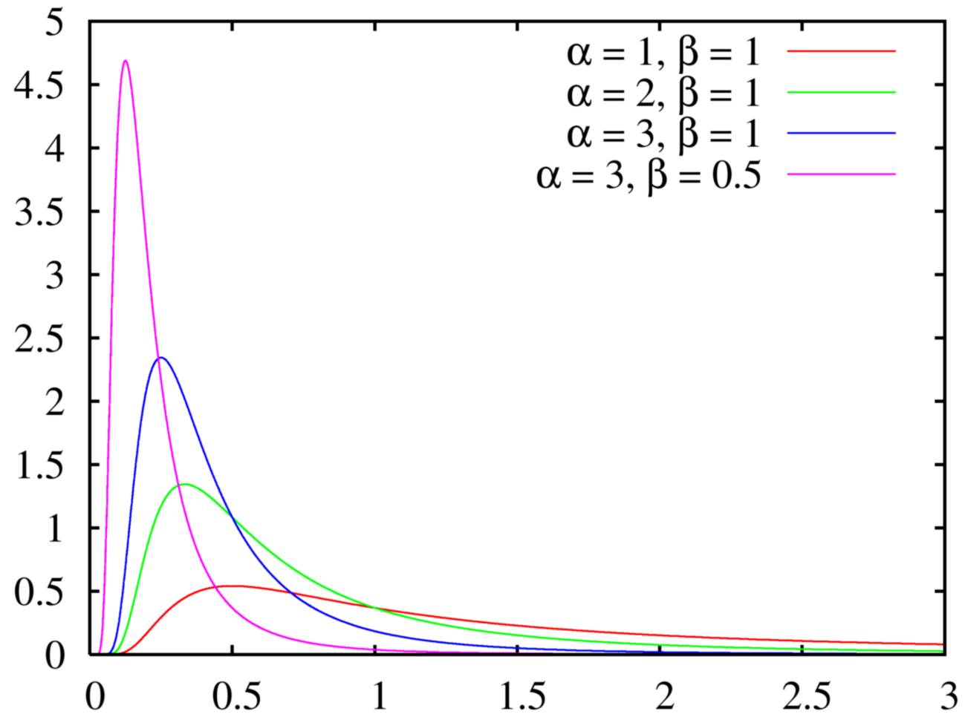
IG mean = α / (α-1) variance = β²/(α -1)² (α-2)

Slide 80
Example: logistic model
Experiment: proportion of seeds that germinated on each of 21 plates arranged as a 2 by 2 factorial layout by seed and type of root extract
r_{i} and n_{i} are the number of germinated and the total number of seeds on the ith plate, i =1,...,N
Here y_{i} = r_{i}; θ_{i} = p_{i} = probability of germination on the ith plate

Slide 81
Logistic model
r_{i} ~ Binomial(p_{i}, n_{i})
logit(p_{i}) = α₀ + α₁x_{1i} + α₂x_{2i} + α₁₂x_{1i}x_{2i} + b_{i}
b_{i} ~ Normal(0, σ²)
α₀, α₁, α₂, α₁₂ ~ Normal(0 , 1.0E6)
σ ~ U(0,100)
Extra-binomial variation
1.0 E6 = 1000000
1.0 E-6=0.000001

Slide 82
DAG for logistic model

Slide 83
Example: random effects linear model
30 rats, weighed weekly for 5 weeks
Model as random effects linear growth curve
Weight Y_{ij} of rat i on day x_{j}
x_{j} = 8 15 22 29 36
Rat 1 151 199 246 283 320
Rat 2 145 199 249 293 354
…
Rat 30 153 200 244 286 324

Slide 84
Rats model
Model
y_{ij} ~ Normal (α_{i} +β_{i} x_{j}, σ_{C}² )
Priors
α_{i} ~ Normal ( α_{C} , σ_{α}² )
β_{i} ~ Normal ( β_{C} , σ_{b}² )
α_{C} ~ Normal ( 0 , 1E4 )
β_{C} ~ Normal ( 0 , 1E4 )
σ_{C} ~ Uniform ( 0 , 100 )
σ_{α} ~ Uniform ( 0 , 100 )
σ_{β} ~ Uniform ( 0 , 100 )

Slide 85
DAG for rats example
α_{C}
σ_{α}
β_{C}
σ_{β}
α_{i}
β_{i}
σ_{C}
μ_{ij}
x_{j}
Y_{ij}
Rats i
Days j

Slide 86
End of session 1 First part of session 2: MC and MCMC Second part of session 2: back to these slides

Slide 87
Recall linear regression
β | y,X, σ² ~ MVN( (Σ₀⁻¹ β₀ + X^{T}y/σ²)/(Σ₀⁻¹ + X^{T}X/σ²),
(Σ₀⁻¹ + X^{T}X/σ²) ⁻¹ )
σ² | y,X, β ~ IG( (ν + n)/2,
(δ + y^{T}y − 2β^{T}X^{T}y + β^{T}X^{T}Xβ)/2 )

Slide 88
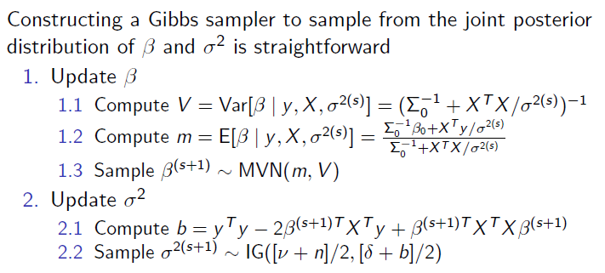
Computation: linear regression

Slide 89
WinBUGS
Windows version of ‘Bayesian Analysis Using Gibbs Sampling’
Also available: OpenBUGS
Can call WinBUGS from R, Matlab, etc
Can program MCMC using R, Fortran, C etc
See also First Bayes and other specialist programs

Slide 90
Running WinBUGS
Model: Specification
Check model
Load data
Compile
Load or generate initial values for simulations
2. Inference
Model: Update: run chain for short time (burn-in)
Inference: Samples: Monitor parameters of interest
Model: Update: run chain for longer time (collection)
Inference: Samples: Summary statistics, plots etc

Slide 91
Example: BUGS code for seeds
model{
for (i in 1:N) {
r[i] ~ dbin(p[i],n[i])
b[i] ~ dnorm(0.0,tau)
logit(p[i]) =
alpha0+alpha1*x1[i]+alpha2*x2[i]+alpha12*x1[i]*x2[i]+b[i]
}
alpha0 ~ dnorm(0 , 1.0E-6)
alpha1 ~ dnorm(0 , 1.0E-6)
alpha2 ~ dnorm(0 , 1.0E-6)
alpha12 ~ dnorm(0 , 1.0E-6)
sigma ~ dunif(0 , 100)
tau <- 1/(sigma*sigma)
}
Beware! WinBugs uses precisions
1/σ² for normal distributions!

Slide 92
Example: BUGS code for rats
N = no. rats, T = no. time periods
model{
for (i in 1:N) {
for (j in 1:T) {
mu[i,j] <- alpha[i] + beta[i] * (x[j] - x.bar)
Y[i,j] ~ dnorm(mu[i,j], tau.c)
}
alpha[i] ~ dnorm(alpha.c, tau.alpha)
beta[i] ~ dnorm(beta.c, tau.beta)
}
alpha.c ~ dnorm (0, 1.0E-4)
beta.c ~ dnorm (0, 1.0E-4)
tau.c <- 1/(sigma.c*sigma.c)
sigma.c ~ dunif (0, 100)
tau.alpha <- 1/(sigma.alpha*sigma.alpha)
sigma.alpha ~ dunif (0, 100)
tau.beta <- 1/(sigma.beta*sigma.beta)
sigma.beta ~ dunif (0, 100)
x.bar <- mean( x[] )
alpha0 <- alpha.c - beta.c * x.bar
}

Slide 93
Trace plots for rats

Slide 95
Bayesian analysis via R
Many packages are now available: http://cran.r-project.org/web/views/Bayesian.html
Example: bayesm
runireg: Gibbs Sampler for Univariate Linear Model
rhierLinearModel: Gibbs Sampler for Hierarchical Linear Model
hierLinearModel: Gibbs Sampler for Hierarchical Linear Model
Example: MCMCPack
MCMCLogit: MCMC for logistic regression

Slide 96
Your turn: Linear modelling with WinBUGS
Read the RATS example in the Help Examples Vol 1 and do the following:
Make sure that you understand the model.
Make sure that you understand the WinBUGS code for the model and priors.
Run this model. (ie check the model, enter the data, validate the model, update, monitor, update, summarise, etc).
Write down the posterior estimates of the overall growth parameters.

Slide 97
Your turn: More with WinBugs
Continue with the RATS example and experiment with changing the code to reanalyse the data excluding the first 10 rats. To do this:
Open a new file in WinBugs (File New).
Copy the original data, model and initial values to the new file.
Delete the first 10 rats in the dataset.
Modify the Model and Initial Values files to allow for this change.
Run the analysis again. What difference do you see in the results?

Slide 98
Your turn: using R (bayesm) for linear modelling
Install and load bayesm
Read the documentation for runiregGibbs
Run the example given in the documentation (see next slide)
Use this package to analyse the environmental health study data given in the previous example

Slide 99
bayesm code for linear modelling
# set number of iterations
R = 10000
# simulate data
X=cbind(rep(1,n),runif(n))
beta=c(1,2)
sigsq=.25
y=X%*%beta+rnorm(n,sd=sqrt(sigsq))
# set data
Data1=list(y=y,X=X)
Mcmc1=list(R=R)
# run analysis
out=runiregGibbs(Data=Data1,Mcmc=Mcmc1)
# print output
cat("Summary of beta and Sigma draws",fill=TRUE)
summary(out$betadraw,tvalues=beta)
summary(out$sigmasqdraw,tvalues=sigsq)
plot(out$betadraw)

Slide 100
Your turn: Do it yourself
For an environmental health study we want to relate
Y = amount of ammonia escaping in an industrial plant
X = temperature
X=c(27,27,25,24,22,23,24,24,23,18,18,17,18,
19,18,18,19,19,20,20)
Y = c(42, 37, 37, 28, 18, 18, 19, 20, 15, 14, 14,
13, 11, 12, 8, 7, 8, 8, 9, 15)

Slide 101
Do it yourself
The aim is to fit a simple regression
y=a+bx
to the data on the previous slide
Open a new file in WinBUGS
Write a simple regression model in WinBUGS code
Type the data in your file, in a form that WinBUGS will read
Type some initial values in your file, in a form that WinBUGS will read. OR let WinBUGS generate the initial values
Run the model in WinBUGS

Slide 102
Possible code for regression
model{
for( i in 1 : N ) {
Y[i] ~ dnorm(mu[i],tau)
mu[i] <- alpha + beta * x[i]
}
beta ~ dnorm(0.0, 1.0E-6)
alpha ~ dnorm(0.0,1.0E-6)
sigma1 ~ dunif(0,100)
tau <- (1/sigma*sigma)
}
Data
list( N=20, x=c(27,27,25,24,22,23,24,24,23,18,18,17,18,19,18,18,19,19,20,20),
Y=c(42, 37, 37, 28, 18, 18, 19, 20, 15, 14, 14, 13, 11, 12, 8, 7, 8, 8, 9, 15)
)

Slide 103
Recap
What is the difference between a likelihood, a prior, a posterior and an initial value?
What is a conjugate prior? Give an example
Describe the general concept of MCMC
How do you obtain a 95% credible interval for a parameter using MCMC?

Slide 104
What about convergence?
As with all simulation methods, we need to make sure that:
the simulations have converged to the right distributions
the whole distribution is being explored in the simulation
we have run the simulations long enough to obtain adequate estimates

Slide 105
How do we do this?
Theoretical results
Diagnostics:
Can you detect ‘burn-in’?
Do multiple chains show dependence on initial values?
Do the (time series) trace plots show that the chain is ‘stable’ around a mean value?
Are the posterior density plots smooth and well behaved?
Are the common diagnostic tests passed?

Slide 106
Theoretical Results
sup_{x∈C}|P^{n}(x,C)-P∞(C)|≤Mρ^{n}_{C}
∫P(x,dy)V(y) ≤(1-β)V(x)+I_{C}(x)

Slide 107
Visual assessment of multiple chains

Slide 108
Convergence: Geweke (1992)
Look at a single long run
Test for equal mean for
“early” part (1st quarter) and
“late” part (2nd half) of the chain
Test statistic is Z~N(0,1) if the sample is all from the same distribution.
(This is only a test of “non-convergence”)

Slide 109
Convergence: Gelman & Rubin (1992)
Many long runs from different starting points
Convergence assessed via an ANOVA
between and within the chains
Monitor convergence by R: a conservative estimate of how much extra information about the variable that we could expect to gain by running the chains indefinitely R tends to 1 as n tends to infinity R is subject to sampling variation so monitor R and its upper 97.5% confidence limit
Works best when posterior is approx. normal (may need to transform some variables, eg probs, variances)

Slide 110
Convergence: Raftery & Lewis (1992)
Look at a single long run
Reduce to two-state Markov chain and use this theory
Diagnostic estimates: n0 = length of burnin N = additional iterations needed to estimate a posterior quantile adequately
Can give quite different estimates depending on starting values and required accuracy of estimation

Slide 111
Convergence: Heidelberger & Welch (1983)
Look at a single long run
Hypothesis test based on Brownian bridge theory and spectral density estimation
Iterative procedure: - test H0: entire sample of values for a given variable form a stationary process - if H0 rejected, discard first 10% and repeat test - continue discarding until H0 accepted or 50% samples are discarded (need to run chain for longer)
Test has very low power to detect lack of convergence for small sample size.

Slide 112
Convergence assessment in WinBUGS
Trace plots
Autocorrelation
BGR diagnostic

Slide 113
BGR diagnostic in WinBUGS
Brooks-Gelman-Rubin convergence statistic
Compare variation between & within multiple chains
The width of the central 80% interval of the pooled runs is green, the average width of the 80% intervals within the individual runs is blue, and their ratio R (= pooled / within) is red
Want convergence of R to 1
Want convergence of both the pooled and within interval widths to stability

Slide 114
Model evaluation posterior predictive checks
Compare observed statistics with values predicted under the model
Compare observed data with replicated data
- if the model is adequate, replicated data generated under the model should look similar to the observed data

Slide 115
Model Comparison
Bayes factors, posterior odds, BIC, DIC
Reversible jump MCMC Birth and death MCMC
Model averaging

Slide 116
Bayes factors
Consider models M₁ and M₂ (not nec. nested)
Choose a model based on its posterior probability given the data. This is proportional to the prior probability of the model multiplied by the likelihood of the model given the data.
So we consider:
p(M₂|y) / P(M₁|y) = {p(M₂) / p(M₁)} × {p(y|M₂) / P(y|M₁)}

Slide 117
Bayes factors
p(M₂|y) / P(M₁|y) = {p(M₂) / p(M₁)} × {p(y|M₂) / P(y|M₁)}
The second term (the ratio of marginal likelihoods) is termed the Bayes factor B₂₁ and is similar to a likelihood ratio, but p(y|M) is integrated over the parameters instead of maximised:
eg, p(y|M₁) = ∫ p(y|M₁,θ₁) p(θ₁) dθ₁
2log(B₂₁) gives same scale as usual deviance and LR statistics.

Slide 118
Guidelines for Bayes Factors (arbitrary!)
B₂₁ 2log(B₂₁) Interpretation
<1 Negative Support for M₁
1 to 3 0 to 2 Weak support for M₂
3-20 2-6 Support for M₂
20-150 6-10 Strong evidence for M₂
>150 >10 Very strong support for M₂

Slide 119
Bayesian Information Criterion BIC
Approximate the Bayes factor
Assume the prior for θ given a model is multivariate normal and that the prior is equivalent to a single extra observation
p is the number of parameters
n is the number of observations
BIC = log P(y|θ*,M) – (p/2) log n
Can rewrite as BIC = n log(1-R²) + k log(n)

Slide 120
Discussion of BIC
BIC penalises models which improve fit at the expense of more parameters (encourages parsimony)
A problem is that the true dimensionality (number of parameters p) of the model is often not known, and also that the number of parameters may increase with sample size n.
Can approximate using the effective number of parameters (Speigelhalter et al, 1999)
Alternatives are DIC (deviance information criterion, calculated in WinBUGS), conditional posterior predictive probabilities, etc.

Slide 121
Model Averaging
Instead of choosing a single model, a common practice is model averaging
This is the practice of combining expected values obtained from different models (perhaps describing different combinations of variables) weighted by their corresponding posterior probabilities
Adoption of this approach depends on the aim of the analysis and the trade-off between improved estimation and ease of interpretation

Slide 122
Your turn: using R (bayesm) for linear modelling
Install and load bayesm
Read the documentation for runiregGibbs
Run the example given in the documentation (see also next slide)
Use this package to analyse the environmental health study data given in the previous example.

Slide 123
bayesm code for linear modelling
# set number of iterations
R = 10000
# simulate data
X=cbind(rep(1,n),runif(n))
beta=c(1,2)
sigsq=.25 y=X%*%beta+rnorm(n,sd=sqrt(sigsq))
# set data
Data1=list(y=y,X=X)
Mcmc1=list(R=R)
# run analysis
out=runiregGibbs(Data=Data1,Mcmc=Mcmc1)
# print output
cat("Summary of beta and Sigma draws",fill=TRUE) summary(out$betadraw,tvalues=beta) summary(out$sigmasqdraw,tvalues=sigsq)
plot(out$betadraw)

Slide 124
code for env. health model
library(bayesm)
R = 10000
# read data from a .csv file, with columns Amm, Int, Temp; Int col = 1’s
# wd<-"c://Work/Work13/courses/MISG2013"
# setwd(wd)
# seeds <- read.csv(“seeds.csv")
# attach(seeds)
# alternative: directly enter Amm , Int and Temp in R:
Amm<- c(42,37,37,28,18,18,19,20,15,14,14,13,11,12,8,7,8,8,9,15)
Temp<- c(27,27,25,24,22,23,24,24,23,18,18,17,18,19,18,18,19,19,20,20 )
Int <- rep(1,20)
X=cbind(Int, Temp)
Data1=list(y=Amm,X=X)
Mcmc1=list(R=R)
out=runiregGibbs(Data=Data1,Mcmc=Mcmc1)

Slide 125
code for env. health model (cont)
cat("Summary of beta and Sigma draws",fill=TRUE)
summary(out$betadraw)
summary(out$sigmasqdraw)
plot(out$betadraw)
b0 <- mean(out$betadraw[,1])
b1 <- mean(out$betadraw[,2])
plot(Temp, Amm)
lines(Temp, b0 + b1*Temp)
plot(Amm, Amm, type= ″l″) # note, if you copy this into R, change the “
points(Amm, b0+b1*Temp)
What could you do to improve the fit of this model? (Hint: consider a transformation.)

Slide 126
Your turn: using R (MCMCPack) for linear regression
Install and load MCMCPack
Browse: http://mcmcpack.wustl.edu/files/MartinQuinnMCMCpackslides.pdf
Read the documentation for MCMCregress
Run the example given in the MCMCregress documentation (see also next slide)
Use this package to analyse the environmental health example.

Slide 127
code for example regression
library(MCMCPack)
line <- list(X = c(-2,-1,0,1,2), Y = c(1,3,3,3,5))
line
posterior <- MCMCregress(Y~X, data=line, verbose=FALSE)
posterior <- MCMCregress(Y~X, data=line, verbose=TRUE)
plot(posterior)
raftery.diag(posterior)
summary(posterior)

Slide 128
code for env. health model
Amm<- c(42,37,37,28,18,18,19,20,15,14,14,13,11,12,8,7,8,8,9,15)
Temp<- c(27,27,25,24,22,23,24,24,23,18,18,17,18,19,18,18,19,19,20,20 )
Data1=list(y=Amm,X=Temp)
posterior <- MCMCregress(y~X, data=Data1, verbose=FALSE)
plot(posterior)
raftery.diag(posterior)
summary(posterior)

Slide 129
Your turn: using R (MCMCPack) for linear logistic regression
Read the documentation for MCMClogit
Run the example given in the MCMClogit documentation (see also next slide)
How would you use this package to analyse the seeds example?

Slide 130
MCMCPack example: logistic regression
library(MCMCPack)
data(birthwt)
?MCMClogit
?birthwt
summary(birthwt)
names(birthwt)
posterior <- MCMClogit(low~age+as.factor(race)+smoke, data=birthwt) plot(posterior)
summary(posterior)

Slide 131
More modelling in R using bayesm
Bivariate normal Gibbs sampler:
In your own time, read the documentation for rbiNormGibbs and run the example.
Hierarchical linear model:
In your own time, read the documentation for rhierLinearModel and run the example.
Would this be applicable to the Rats example? If so, how?

Slide 132
Your turn: model assessment and comparison in WinBugs
Using WinBUGS, run the Seeds example with and without the interaction term.
What is the difference in goodness of fit of the models as measured by the DIC? (A smaller DIC indicates a better fit.)
Run some iterations. Choose the DIC option from the ‘Inference’ menu and set DIC. Run some more iterations. Return to the DIC box. Use the ‘Total DIC’.

Slide 133
Your turn: model assessment and comparison in R
Read the documentation for the package BayesFactor in MCMCPack
Using R, run the environmental health example with the following models and compute the BF for each:
y ~ X
log(y) ~ X
y ~ X + X
Based on the Bayes Factor, what model would you choose for these data?

Slide 134
Code for BF in the env. health example
Amm<- c(42,37,37,28,18,18,19,20,15,14,14,13,11,12,8,7,8,8,9,15)
Temp<- c(27,27,25,24,22,23,24,24,23,18,18,17,18,19,18,18,19,19,20,20 )
post1 <- MCMCregress(Amm~Temp, b0=1, B0=1e-6,
marginal.likelihood="Chib95")
post2 <- MCMCregress(log(Amm)~Temp, b0=0, B0=1e-6,
marginal.likelihood="Chib95")
Temp2 <- Temp**2
post3 <- MCMCregress(Amm~Temp+Temp2, b0=1, B0=1e-6,
marginal.likelihood="Chib95")
raftery.diag(post1); raftery.diag(post2); rafter.diag(post3)
summary(post1) ; summary(post2); summary(post3)
BayesFactor(post1, post2, post3)

Slide 135
References
C.P. Robert and G. Casella
Monte Carlo Statistical Methods, 1999
Méthodes de Monte-Carlo avec R, 2011
C.P. Robert and J.M. Marin Bayesian Core: A practical approach to computational Bayesian analysis, 2007
W. R. Gilks , S. Richardson and D. J. Spiegelhalter, Markov chain Monte Carlo in practice, 1996
P. J. Green, Reversible Jump Markov-chain Monte Carlo computation and Bayesian model determination, Biometrika, 1995

